Slide 1

Lambda Calculus, Javascript and Functional Programming

Slide 2
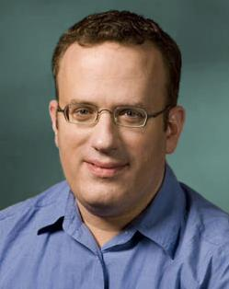
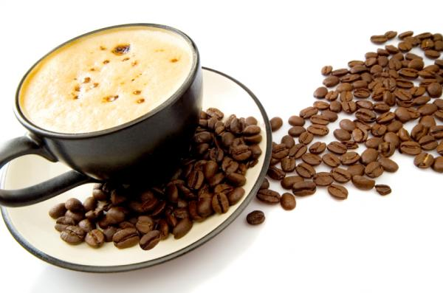
History of Javascript
Origin
Developed by Brendan Eich, 1995
Developed under name “Mocha” and beta was shipped with Netscape Navigator as “Livescript”
When Navigator 2.0B3 Released, was changed to Javascript
Eich later went on to help found Mozilla.org and is currently a CTO at the Mozilla Corporation

Slide 3
History of Javascript
Origin
Gained widespread success as a client side scripting language for web pages
One year (1996) later Microsoft introduced support in Internet Explorer 3.0
Ecma international published standardized version of Javascript in 1997 as ECMAScript
Brendan Eich “ECMAScript was always an unwanted trade name and sounds like a skin disease.”

Slide 4
History of Javascript
Functional Characteristics and Lambda-calculus
Anonymous function
allows us to pass a function as a parameter of another function. There is no strict rule to have name on the functions.
Variable scoping
stores the local references to the local variables presented in the same scope as the function itself even after the function return.
Function application
the arguments are reduced by applying them into the function. In lambda-calculus, this is referred as β-reduction

Slide 5
Lazy Evaluation
The expression is not evaluated until it is needed
Offers improvements in expressiveness and when dealing with the declaration of very large arrays
Would allow a user to work on an infinite array, or array of very large unknown size, without predetermining the size or storing the entire array
JavaScript library stream.js provides infinite “stream” capabilities via a stream data structure
Lazy.js an experimental library supporting lazy evaluation

Slide 6
Lazy Evaluation
stream.js
Allows for the creation of a stream (like a list)
var s = Stream.make(10, 20, 30, 40); a stream containing 10, 20, 30, and 40
var t = Stream.range(10, 100); a stream containing 10->100
var u = Stream.range(); a stream containing 1->infinity
function ones() { return new Stream(1, ones); }
this creates a stream where 1 is the head, and the function ones is the tail. It goes on recursively infinitely producing infinite ones
These streams store the data when it is evaluated, so infinite streams do not require infinite memory

Slide 7
Lazy Evaluation
Lazy.js
A javascript utility library allowing for some lazy evaluation
Works with streams
Ex) Say we want the first 5 lines of a very large block of text we could do:
var firstFiveLines = text.split("\n").take(5);
But this produces an array of every single line and then takes the first 5, whereas:
var firstFiveLines = Lazy(text).split("\n").take(5);
produces an array of only the first 5 lines.
This, in combination with stream.js allows for a lazy implementation of many javascript functions

Slide 8
Higher-Order Functions and Closure
Definitions
Closure: A function combined with a table (referencing environment) storing all the function’s free variables
Free Variable: A variable used inside a function in which it is not declared
Closures allow a function to access free variables even when it is invoked outside of the variable’s scope

Slide 9
Higher-Order Functions and Closure
How JavaScript implements closure
Every time a function is executed a scope object is created to hold the local variables
function parentFunction(string) {
var name = string;
function innerFunction() {
alert (name);
}
return innerFunction();
}
var myFunc = parentFunction("CSC 330");
var myFunc2 = parentFunction("CSC 100");
myFunc(); //alerts(“CSC 330”)
myFunc2(); //alerts(“CSC 100”)
When the innerFunction is executed via myFunc/myFunc2 it access the scope object that is created upon the execution of its parent function

Slide 10
Higher-Order Functions and Closure
Higher Order Functions in JavaScript
A function that can take one or more functions as input, or that can output a function
An example is the map function, it takes a list and a function and applies the function to each element of the list
JavaScript does not have built in higher order functions but they are easy to create:
function Map(array, func) {
for (var i = 0; i < array.length; i++) {
if(i in array) {
func(array[i]);
}
}
}
The FUNCTIONAL library provides many popular higher order functions such as map and reduce

Slide 11
List Comprehension
Generators
Haskell
Used to generate a sequence of elements, the following sets values for x and y
Multiple generators can be used in one statement
[(x, y) | x <- [1..10], y <- [1..x]]
Javascript
Uses yield in conjunction with a function a sequence of elements
function range(begin, end) {
for (let i = begin; i < end; ++i) {
yield i;
}
}
the function returns the var associated with the yield statement on each iteration, and then stops
range() reiterates itself immediately following the yield; via closure range() retains the value of i
Notes:
Haskell code sets

Slide 12
List Comprehension
Predicates and Range
Haskell
Fully supports predicates
Items = [ 3*x | x <- [0..10], x^2 > 5 ]
In the above example only values where x^2 > 5 evaluates true are accepted
Javascript
Does not directly include support for predicates
Similar functionality can be implemented via statements like IF:
var items = [3*x for (x in 10) if x^2<5)]
the provides the same result as a predicate in Haskell
Defining the range of a list requires the use of a generator function as seen on the previous slide
var items = [2*x for (x in range(2,10)) if (x*x<5)].
Notes:
Haskell code sets

Slide 13
List Comprehension
Recap
Both support very similar features
Difference is how the features are handled and applied
Haskell is typically able to implement generators and predicates in one statement, providing much more simple comprehension.

Slide 14
Key Takeaways
JavaScript was developed in ‘95 by Brendan Eich as a client side webpage scripting language
Allows for passing of functions to functions
Allows for function application a.k.a. β-reduction in lambda-calculus
Lazy evaluation provided through extra libraries stream.js and lazy.js
Support for both closure and higher order functions in Javascript
Both Haskell and Javascript allow for list comprehension via generators and predicates, however Haskell is much more simple

Slide 15
Questions?

